Slide 1
Cladogram of taxa analysed for Blattabacterium HGT events
Number of HGT inserts
Nodes show divergence times (Ma) from Beasley-Hall et al (2021: for nodes internal to top 12 taxa) and Evangelista et al (2019: for nodes internal to remaining 6 taxa). One exception is value between P. lata
and P. cribrata, which is from Adams et al 2024.
6.67
Macropanesthia lithgowae Z004 (Murgon)
5037
12.73
Panesthia tryoni tryoni Z005 (Kroombit Tops)
4252
5.84
Panesthia gigantea Z020 (location TBD)
3852
14.12
Panesthia tryoni tegminifera Z011 (Washpool)
3702
20.91
13.17
Neogeoscapheus dahmsi Z014 (location TBD)
4716
Panesthia tryoni tryoni Z012 (Eungella)
4086
22.84
Geoscapheus dilatatus (Gilgandra)
4396
28.71
17.35
Panesthia sloanei Z001 (Mt Baldy)
2964
Neogeoscapheus hanni (Mt Molloy)
2797
63.05
1.81
Panesthia cribrata (North Manly)
1543
145
Panesthia lata M001 (Lord Howe Island)
1601
Diploptera punctata
532
Blattella germanica
527–609
207
45
Reticulitermes lucifugus
0
Kyle and Maxim:
Are these termite numbers
right? When I did an audit in early 2025 I found none were Blattabacterium?
98
Coptotermes formosanus
0
108
Termites
Cryptotermes secundus
0
161
Zootermopsis nevadensis
1
Periplaneta americana
106-647

Slide 2
Figure 1
Number of HGT inserts
Total Unique
6.67
Macropanesthia lithgowae
4955
4900
4193
4117
12.73
Panesthia tryoni tryoni (Kroombit Tops)
3794
3766
5.84
Parapanesthia gigantea
14.12
3673
3637
Panesthia tryoni tegminifera
4619
4561
20.91
13.17
Neogeoscapheus dahmsi
4031
3926
Panesthia tryoni tryoni (Eungella)
22.84
Geoscapheus dilatatus
4257
4226
2920
2845
17.35
Panesthia sloanei
28.71
2751
2705
Neogeoscapheus hanni
1532
1499
63.05
1.81
Panesthia cribrata
1588
1575
Panesthia lata
145
511
506
Diploptera punctata
278-285
277-280
Blattella germanica
207
0
0
45
Reticulitermes lucifugus
0
0
98
Coptotermes formosanus
108
Termites
0
0
Cryptotermes secundus
161
Zootermopsis nevadensis
0-1
0-1
Periplaneta americana
93-644
101-658
Notes:
Cladogram of taxa analysed for Blattabacterium HGT events
Nodes show divergence times (Ma) from Beasley-Hall et al (2021: for nodes internal to top 12 taxa) and Evangelista et al (2019: for nodes internal to remaining 6 taxa). One exception is value between P. lata
and P. cribrata, which is from Adams et al 2024.

Slide 3
Figure SX – alternative filtering
Number of HGT inserts
Total Unique
6.67
Macropanesthia lithgowae
5841
5669
4865
4680
12.73
Panesthia tryoni tryoni (Kroombit Tops)
4378
4261
5.84
Parapanesthia gigantea
14.12
4248
4132
Panesthia tryoni tegminifera
5389
5260
20.91
13.17
Neogeoscapheus dahmsi
4621
4492
Panesthia tryoni tryoni (Eungella)
22.84
Geoscapheus dilatatus
4822
4690
3414
3283
17.35
Panesthia sloanei
28.71
3120
3056
Neogeoscapheus hanni
1814
1741
63.05
1.81
Panesthia cribrata
1849
1802
Panesthia lata
145
875
839
Diploptera punctata
246-840
226-793
Blattella germanica
207
46
46
45
Reticulitermes lucifugus
6
6
98
Coptotermes formosanus
108
Termites
9
9
Cryptotermes secundus
161
2-50
2-42
Zootermopsis nevadensis
Periplaneta americana
517-526
543-555
Notes:
Cladogram of taxa analysed for Blattabacterium HGT events
Nodes show divergence times (Ma) from Beasley-Hall et al (2021: for nodes internal to top 12 taxa) and Evangelista et al (2019: for nodes internal to remaining 6 taxa). One exception is value between P. lata and P. cribrata, which is from Adams et al 2024.

Slide 4
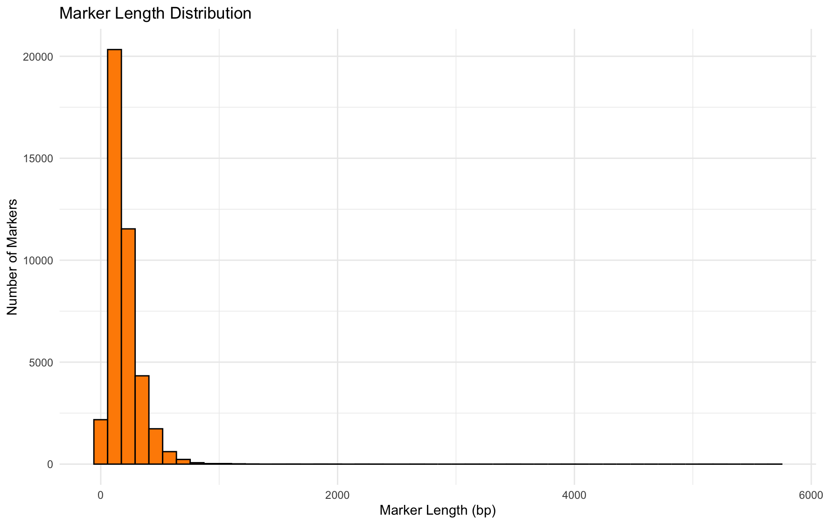

Slide 5
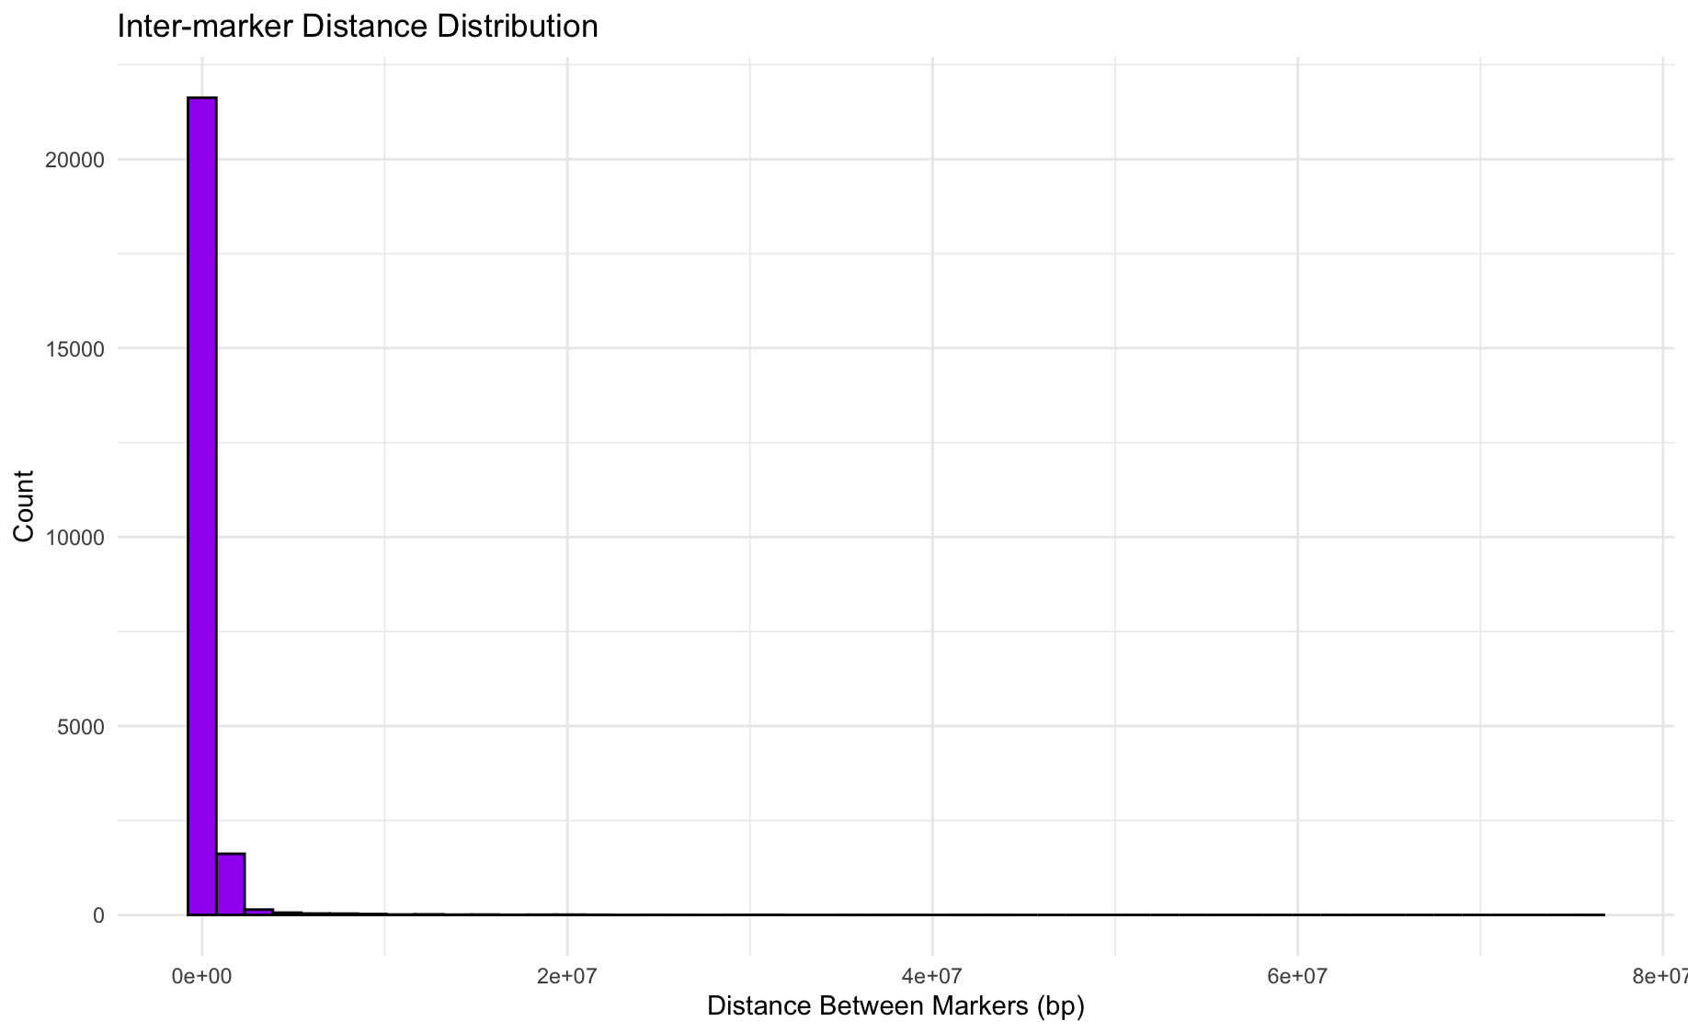
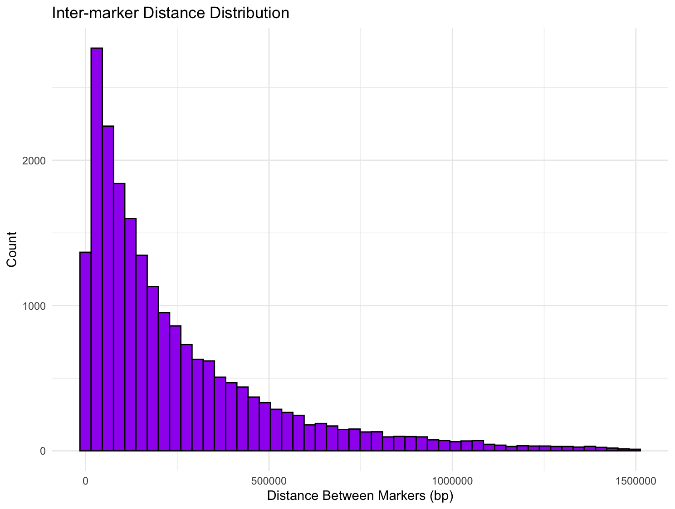
Filtered lengths <2500 bp, and <1.5 Mb

Slide 6
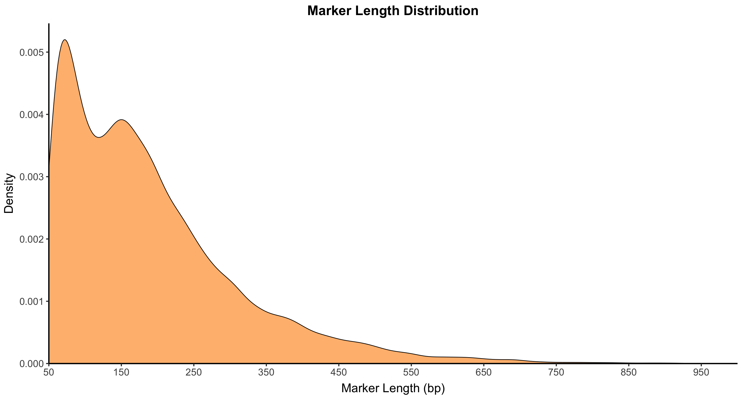
Notes:
Made with “inserts_lengths_v2.R”
The plot starts at 50 bp, as this was the minimum. I have a maximum cutoff of 1000 bp (75 of the 41103 markers have been excluded).
Comment 1: I’m not sure why there are 2 peaks… I can of course fiddle around with the resolution of this graph and flatten out the 2 peaks (not to be dodgy, but just a more coarse summary of the lengths)
Comment 2: I’m hoping to add 2 additional curves to the plot (or as additional plots) – 1 for genic and 1 for intergenic.

Slide 7
Marker length distribution with: inserts_lengths_v3.R

Slide 8
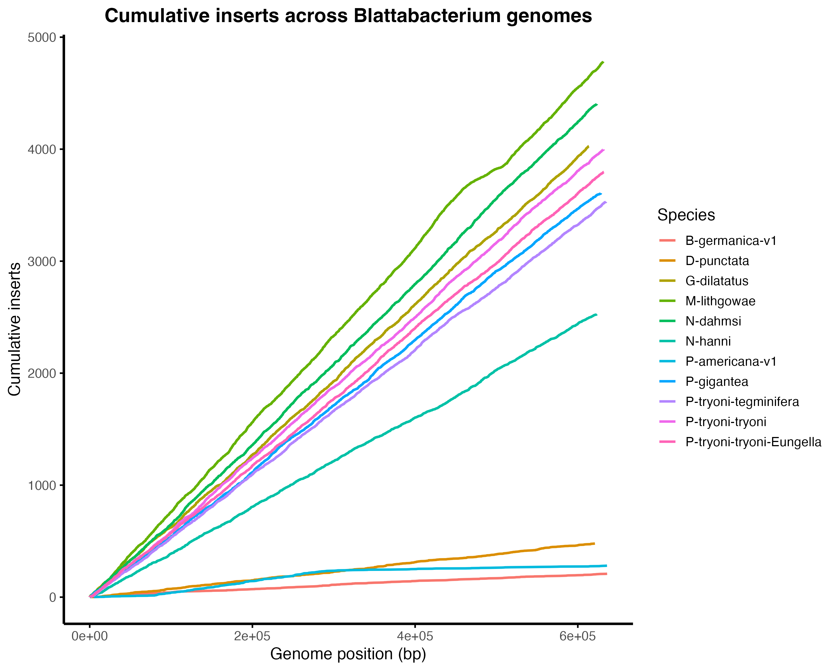
Insert origins

Slide 9
5000
Macropanesthia lithgowae
Neogeoscapheus dahmsi
4000
Geoscapheus dilatatus
Panesthia tryoni tryoni (Kroombit Tops)
Panesthia tryoni tryoni (Eungella)
Parapanesthia gigantea
Panesthia tryoni tegminifera
3000
Cumulative insert count
Neogeoscapheus hanni
2000
1000
Diploptera punctata
Periplaneta americana
0
Blatella germanica
0
200
400
600
Blattabacterium genome position (kb)

Slide 10
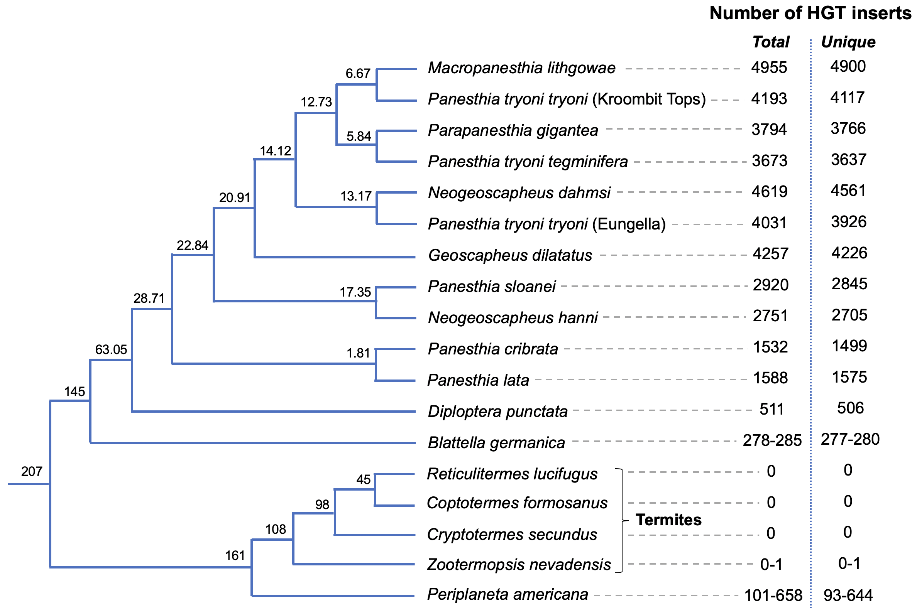
A
B
C. Placeholder: depiction of the origin of the insert around the Blatta genome (waiting on Leo)
Notes:
A. Cladogram of taxa analysed for Blattabacterium HGT events
Nodes show divergence times (Ma) from Beasley-Hall et al (2021: for nodes internal to top 12 taxa) and Evangelista et al (2019: for nodes internal to remaining 6 taxa). One exception is value between P. lata and P. cribrata, which is from Adams et al 2024.
Comment 1: Could add numbers of genic vs intergenic to (A)
B. The plot starts at 50 bp, as this was the minimum. I have a maximum cutoff of 1000 bp (75 of the 41103 markers have been excluded).
C. Placeholder for Leo figure

Slide 11
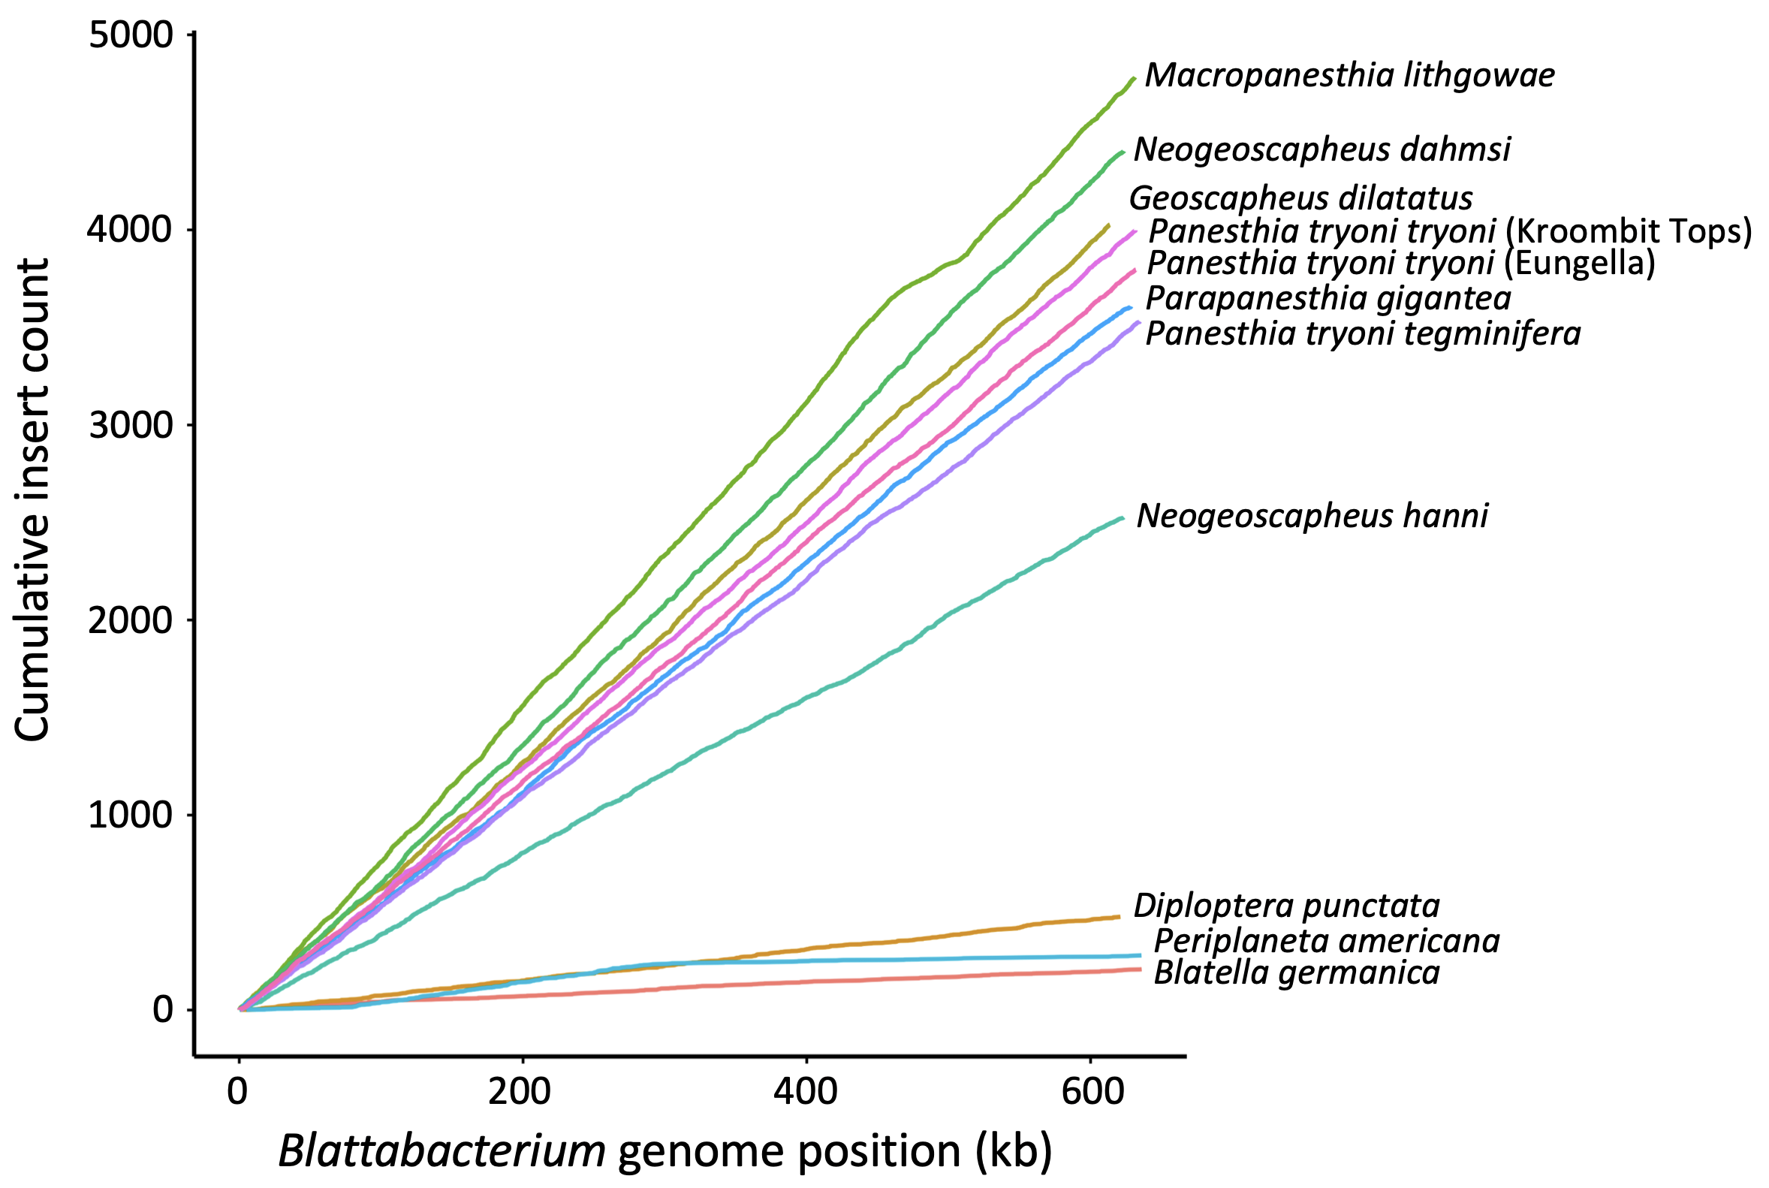
B
A
C

Slide 12
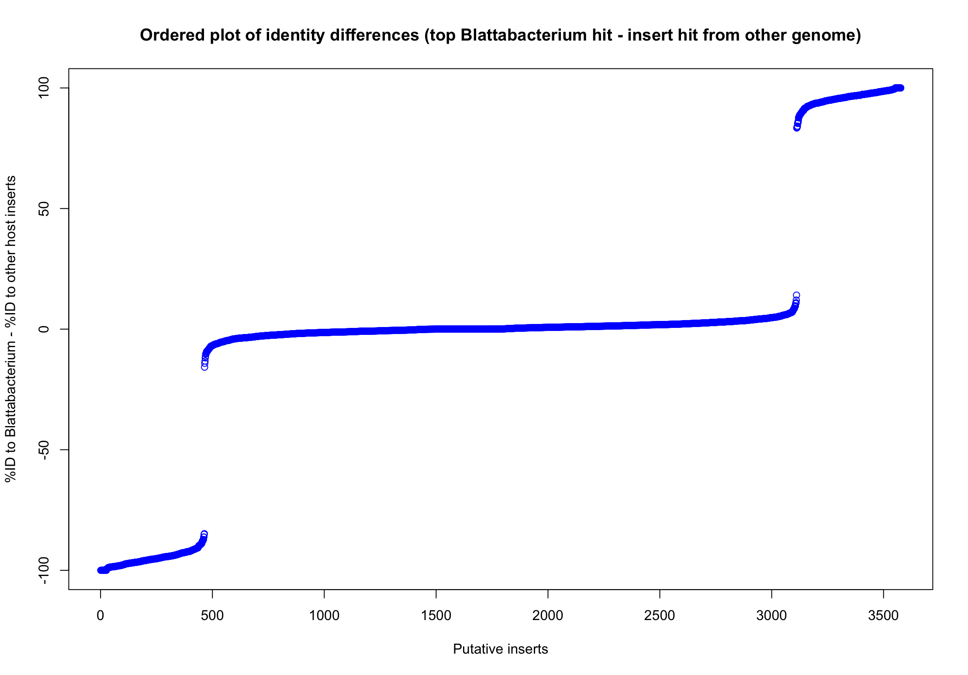
Figure 2
A
B
Putative contemporary inserts
BLAST identity (%) difference
Unable to infer age
Putative ancestral inserts
Insert count
Notes:
P-tryoni-tryoni-Eungella_ageing-plot. BLAST %ID against Blattabacterium database - BLAST %ID against insert database
B. Examples of one HGT insertions used for ‘aging’ analysis. The right panel shows homology of each insertion and its 5 kb flanking regions across species: green denotes HGT inserts, blue flanking regions, with red and blue bands indicating forward and inverted homology (darker shades = higher similarity). The left phylogeny is based on Chapter 3; species lacking the insertion are shown as a dashed line. Red arrows indicate the inferred timing of HGT insertions.

Slide 13
Notes:
Figure 4.3. Examples of two HGT insertions used for ‘aging’ analysis. The right panel shows homology of each insertion and its 5 kb flanking regions across species: green denotes HGT inserts, blue flanking regions, with red and blue bands indicating forward and inverted homology (darker shades = higher similarity). The left phylogeny is based on Chapter 3; species lacking the insertion are shown as a dashed line. Red arrows indicate the inferred timing of HGT insertions.

Slide 14
Notes:
Example of a chimeric HGT insertion from P. tryoni tegminifera. The top sequence is divided into seven segments, while the circular map below represents the source genome of Blattabacterium cuenoti (CP142624.1). Numbers below the insertion indicate the corresponding genomic positions, with yellow labels marking specific coordinates.

Slide 15
P-tryoni-tryoni-Eungella_ageing-plot

Slide 16
Panesthia tryoni tegminifera contig
Blattabacterium cuenoti genome
Notes:
Example of a chimeric HGT insertion from P. tryoni tegminifera. The top sequence is divided into seven segments, while the circular map below represents the source genome of Blattabacterium cuenoti (CP142624.1). Numbers below the insertion indicate the corresponding genomic positions, with yellow labels marking specific coordinates.

